Slide 1



Buy. Sell. Rent. invest.
WWW.KWNICARAGUA.COM

Slide 2
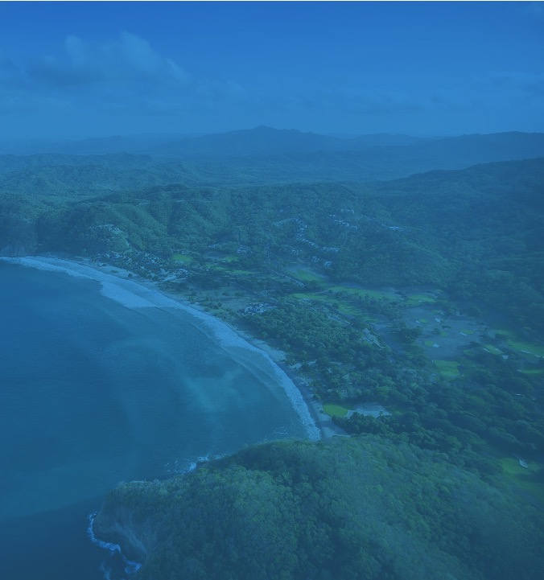

ABOUT US
WWW.KWNICARAGUA.COM
Trinity Real Estate Nicaragua was born with the objective of making the area of the southern coast of Nicaragua as one of the most important tourist destinations in the Americas. This goal will be reached through the consultation of clients and promotion of key properties that will contribute to the correct and organic growth of the area. We believe with certainty that with our help in real estate, we can achieve our purpose together.
We are always looking for tireless, entrepreneurial people, with a thirst for learning and growth to help us reach our goal and help our Nicaragua and its citizens to live in a more prosperous country.
We want everyone around us to live incredible lives and reach their dreams and goals, and for all of us to improve the quality of our lives and our families.

Slide 3


TEAM
Joao Mucciolo
Partner and Broker
(Touristic areas)
San Juan del Sur office, Nicaragua
(505) 8883 – 8829
joao.mucciolo@kwnicaragua.com
Daphne Espinoza
Agent, San Juan del Sur
San Juan del Sur office, Nicaragua
(505) 8429 - 6462
daphne.espinoza@kwnicaragua.com
Gary Clements
Agent, Tola and Rivas
San Juan del Sur office, Nicaragua
Nic (505) 7803 – 9110
USA (1) 240-476-3290
gary.clements@kwnicaragua.com
Nancy Ulloa
Coordinator
San Juan del Sur office, Nicaragua
(505) 8789 - 6940
nanmeul@gmail.com

Slide 4
Professional
Profile
A believer in the franchise business model, Joao invests in Keller Williams to further develop his experience in real estate investments he has made since 2005. He now implements Keller Williams models and systems in his Real Estate business: Trinity Real Estate.
Joao studied International Business Administration at St Mary's University and also studied at the Entrepreneur Masters Program at MIT.
His professional career, his real estate investments, and his continuous studies in subjects of personal growth and leadership make Joao a different and dynamic real estate advisor, giving him opportunities to advise his clients in a unique way and with investment points of view.
Joao has been an entrepreneur since 2003 in Nicaragua, when he introduced the Sushi Itto franchise to the country and created his own Italianissimo brand. He created a company of 6 restaurants and more than 120 direct jobs.
He has contributed to the entrepreneurship of Nicaragua, bringing organizations such as Entrepreneurs Organization and Accelerator with the purpose of contributing to the country through training and helping entrepreneurs. He is a member of the Central American Leadership Initiative of the Aspen Institute where he strengthens his leadership.
Joao Mucciolo
FOUNDING PARTNER
Trinity Real Estates
Together with Veronica they form a beautiful family with their 4 children: Magdalena, Eugenia, Genaro and Tiago. In his free time you can find him surfing the waves of Nicaragua.

Slide 5
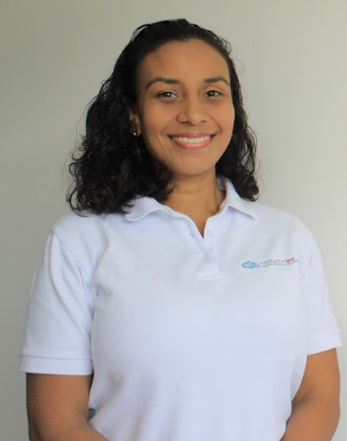
Professional
Profile
This journey in the real estate environment fosters a lot of relationships with extraordinary clients, and achieving their satisfaction is what motivates Nancy the most.
Personally think that there is no place more wonderful than San Juan del Sur to live. Its beaches, its people and the impressive horseshoe bay that everyone falls in love with.
Her motivation for life are her two little daughters of 1 and 4 years who love the sea.
Nancy Ulloa
Assistant
Trinity Real Estates
Nancy is a native of San Juan del Sur. She decided to study Tourism Administration to take advantage of the area's primordial business. However, due to fate, she has been working on the business side of things for over 13 years. She has worked in two luxurious hotels: Pelican Eyes and Guacalito de la Isla, which have helped her to make her way into the real estate world which she is passionate about.

Slide 6
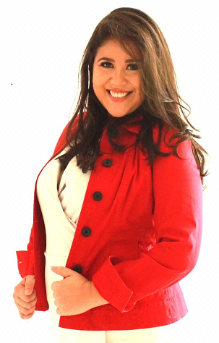
Professional
Profile
under a model that offered an opportunity to develop their own real estate business but also opted for Nicaraguan talent and ability to develop within This business especially women with determination and determined
to conquer the world of real estate in San Juan del Sur. He traveled to Mexico in 2019 for a week to train and learn more about the KW model and systems internationally. I return enthusiastically and in love with the KW model. She met many women in Mexican industry who inspired her to pursue her dream of becoming a mega agent in NICARAGUA. This year he decided to join Joao Mucciolo in Trinity Real Estate of Keller Williams beaches with the aim of establishing a strategic alliance and forming a team with Trinity Real estate, the # 1 company in San Juan del Sur and bringing real estate services to other level.
Daphne Espinoza
Agent, San Juan del Sur
Trinity Real Estates
Daphne is originally from Managua but made the decision to move to San Juan del Sur 5 years ago to work for a community service and education NGO. He has a degree in Diplomacy and international relations and studies in Social Development. She is a faithful believer in the empowerment of women in all functional roles for development. He is a faithful believer in entrepreneurship as a tool for socio-economic development of NICARAGUA especially for young people with determination and talent. Daphne decided to join the Keller Williams franchise in 2018 and start a career in real estate
She has a 5-year-old daughter Kamila who is her greatest inspiration and for whom she wants to leave a legacy of success and love to others.

Slide 7
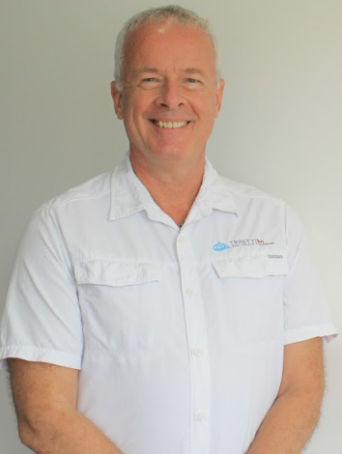
Professional
Profile
Gary Clements
Agent, Tola and Rivas
Trinity Real Estates
Since returning to Nicaragua after his retirement in 2016, Gary has served as the general manager of a homeowners association in Tola where he is responsible for security and maintenance of the common areas. He also owns a transportation business that provides rides to work for the employees of the association and its members, transportation of construction materials, trash pick-up, and other services.
Although Gary is new to the real estate business, he has extensive knowledge of real estate law and practice gained through his experience as a lawyer and diplomat. He speaks English and Spanish fluently.
Gary has a B.A. in Psychology from the State University of New York at Potsdam, and a J.D. from Harvard University. He lives in Rivas with his wife Veronica, their two children, their horse, two dogs and a cat. He enjoys playing golf, reading, and listening to music.
Gary is a retired Foreign Service Officer who devoted his 28-year career to advancing U.S. economic interests abroad. Prior to that, he practiced corporate law for 8 years in and around Boston, Massachusetts.
Gary first came to Nicaragua in 2011 to serve as Economic Counselor at the U.S. Embassy in Managua.

Slide 8

We advise our clients on the processes and strategies of Real Estate. (Price Audit, Customer Profile, Packaging and improvements, etc.)
We analyze each project and design specific marketing strategies.
We use the tools and digital platform of Keller Williams to distribute property information to all our agents.
We provide marketing materials (signs, flyers, etc.).
We develop a digital marketing plan on websites and social networks.
We carry out email campaigns focused on our network of contacts.
ADVICE AND MARKETING
Each project presents a different challenge, we work hand in hand with our clients to identify their needs and define a market strategy adjusted to these needs.

Slide 9


OUR ASSOCIATION TO
Keller Williams
Technology
Keller Williams is not your traditional real estate company. The company bases its business model on the training of its members and on having the largest network of agents worldwide. Keller Williams became in 2017 the # 1 company in the United States
KW arrived in Nicaragua in 2017 and quickly became the largest agent network in the country, thanks to its business model.
Currently, we have more than 200 agents in Nicaragua and 3 regional offices.
Trinity is the #1 team in sales within the KW franchise in Nicaragua
Team Work
Knowledge
Reliability
Background

Slide 10
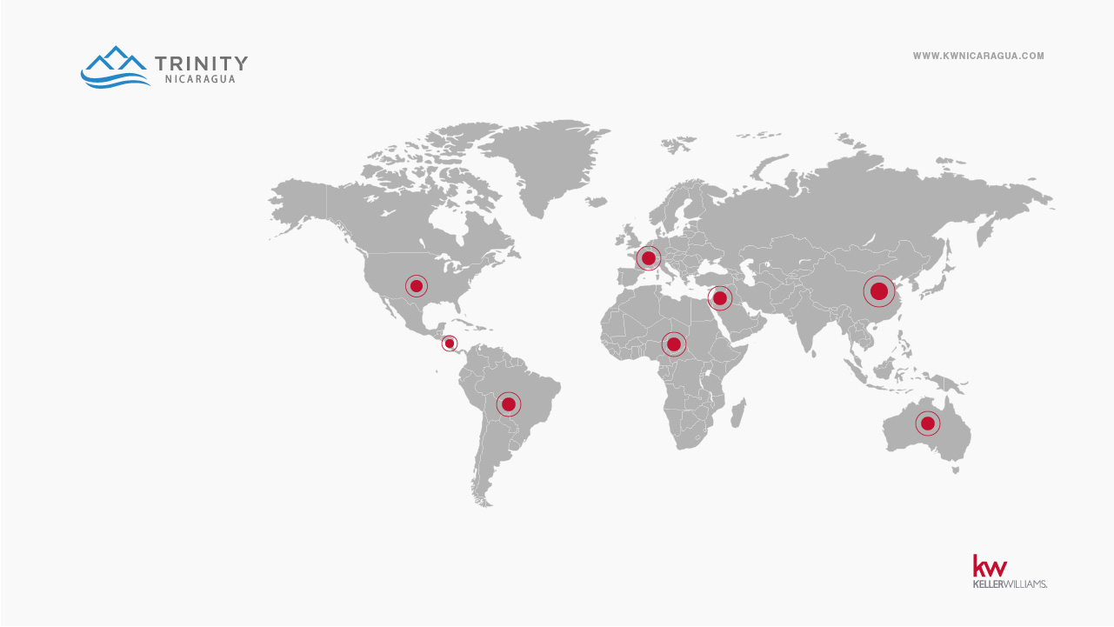
International
presence
KW is found in 36 countries.
It has more than 800 offices in the world.
And more than 180,000 agents worldwide.

Slide 11
We share commission and information with all the real estate agencies in Nicaragua, being more convenient for you to deal only with one agent for the sale of your property.
Assignment of marketing budget and exclusive advertising for your property.
Preparation of presentations to real estate colleagues and potential clients
Distribution of personalized information in all our offices and contacts
Advice to our buyers and sellers from start to finish.
Support in the processes with banks, lawyers, evaluators, etc.
OUR MODEL
EXCLUSIVE REPRESENTATION
AND ITS ADVANTAGES

Slide 12

WHAT SOME OF OUR CLIENTS SAY
“From the minute we started the process of buying our second home in Nicaragua with Joao we knew we had made the right decision. Unlike our first purchase here which was fraught with confusion and anxiety- Joao’s knowledge of the market, the regulations for foreign buyers, , his incredible communication, patience and availability to us, as well his kind manner put us at ease. We have full confidence in him as our relator, and we would not hesitate to recommend his services and knowledge for other serious buyers." Joel and Laura Johnson
"Excellent agent! He gets in your shoes and helps you find the property according to your needs. He helped with analysis, the advantages and disadvantages of each property, all supported by his experience. "Joao offers security and confidence , and that is what I need for my real estate investments.“
Mauricio Aguirreurreta

Slide 13
WHAT SOME OF OUR CLIENTS SAY
"I want to comment that we recently bought a property on one of the beaches in Nicaragua. On this occasion I was recommended to a young man who I personally knew but who I had not made any transactions with yet. Everything that is related to the purchase of property in Nicaragua tends to be complicated, therefore most of the people are suspicious about this.
I want to mention that the experience I had doing this transaction exceeded my expectations. Joao proved to be a person that:
Knows the market.
He has vision.
Committed to his customers.
Passionate about what he does.
Extremely dynamic and business promoter.
He is a gentleman of word and very gentle treatment.
Empowered with service and customer satisfaction.
He lives the philosophy of win-win
Seeks to make a relationship and not a transaction.
For this and many other reasons, I recommend him
Camilo Fernández S.
“The truth is that Joao is a different realtor. I feel that he is a well-committed person and is always looking after his clients during the purchase process and after,. He is constantly offering new alternatives in the market. Other qualities that I see in Joao are harmony, fairness, empathy, tolerance, perseverance. In short he is a realtor out of the ordinary. I know I can count on him 100%, either to buy or sell something, I recommend him with my eyes closed. "
Pedro Álvarez

Slide 14
WHAT SOME OF OUR CLIENTS SAY
The experience of having been advised by Joao for the purchase of property has been very satisfactory because he knows how to interpret the needs of his clients well and knows how to filter and present the offers that meet these requirements. He also advises us well on the way to structure the purchase and sale arrangements: as well as good knowledge of procedures and legal aspects. Personally I had a very good experience working with Joao.
“I can highly recommend working with Joao. The result and the professionalism working trough the entire process of selling your property is world class."

Slide 15
WHAT SOME OF OUR CLIENTS SAY
“I want to express my sincere congratulations for the excellent attention provided during the process of buying a property on a beach in Nicaragua. You were a very patient, persistent, honest property sales agent, dedicated in detail and especially with great tact to close the purchase.
With closed eyes I would recommend you to anyone interested in making a purchase. "
A friend.

Slide 16






Donation
10% of the commission generated will be donated to organizations such as the following:

Slide 17
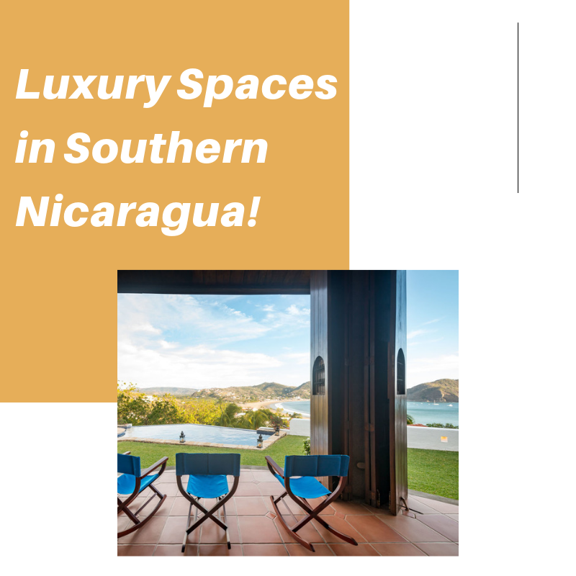


Slide 18
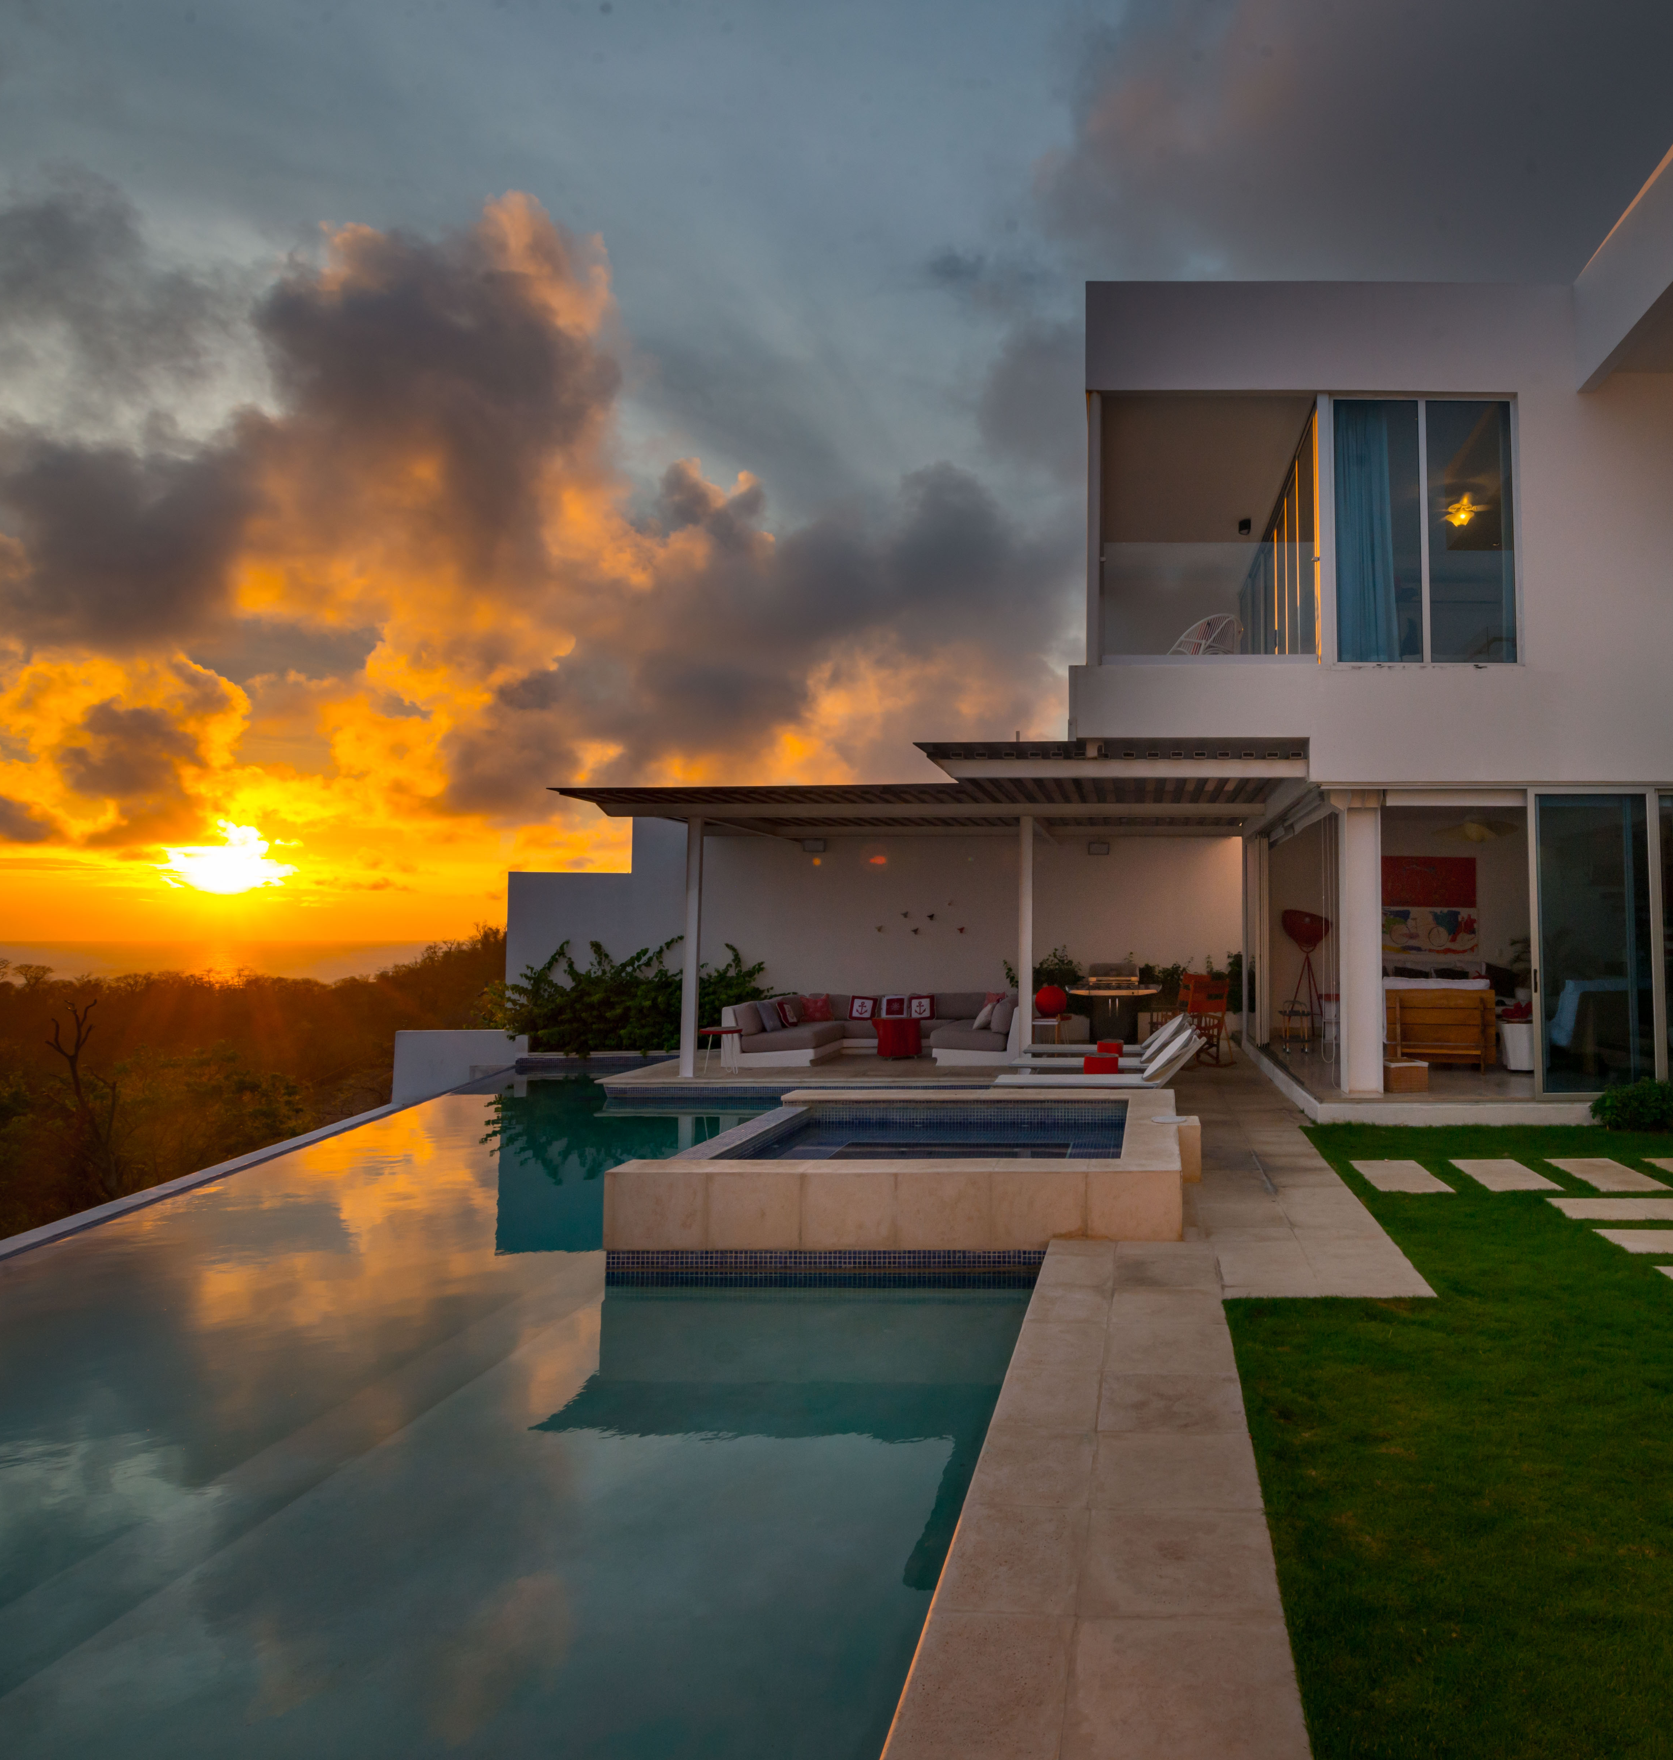
Selva Pacifica Luxury Rentals is re-invigorating the concept of luxury in southern Nicaragua. Formed in 2018 as a response to the lack of a trusted luxury brand for independent vacation rentals in Nicaragua, Selva Pacifica focuses on a small collection of exclusive, hand picked luxury homes. We provide a full service package for marketing, booking and securing rental for home owners, while simultaneously provide guests support, from time of booking to the completion of their vacation. Our clients—both guests and owners—are provided with personalized and detailed, one-on-one, assistance from our team members at Selva Pacifica.
www.selvapacifica.com

Slide 19
TEAM
Laura Johnson
Chief Marketing Officer
Communications Officer
(001) 416-553-6772
selvapacifica@icloud.com
Veronica Hueck
Rentals Specialist** (Meet & Greet)
Oficina San Juan del Sur, Nicaragua
(505) 8884 – 7337
veronicahueck@gmail.com
Joel Johnson
Director Content Strategy
Photographer
(001) 647-239-5007
joel.johnson@mac.com

Slide 20
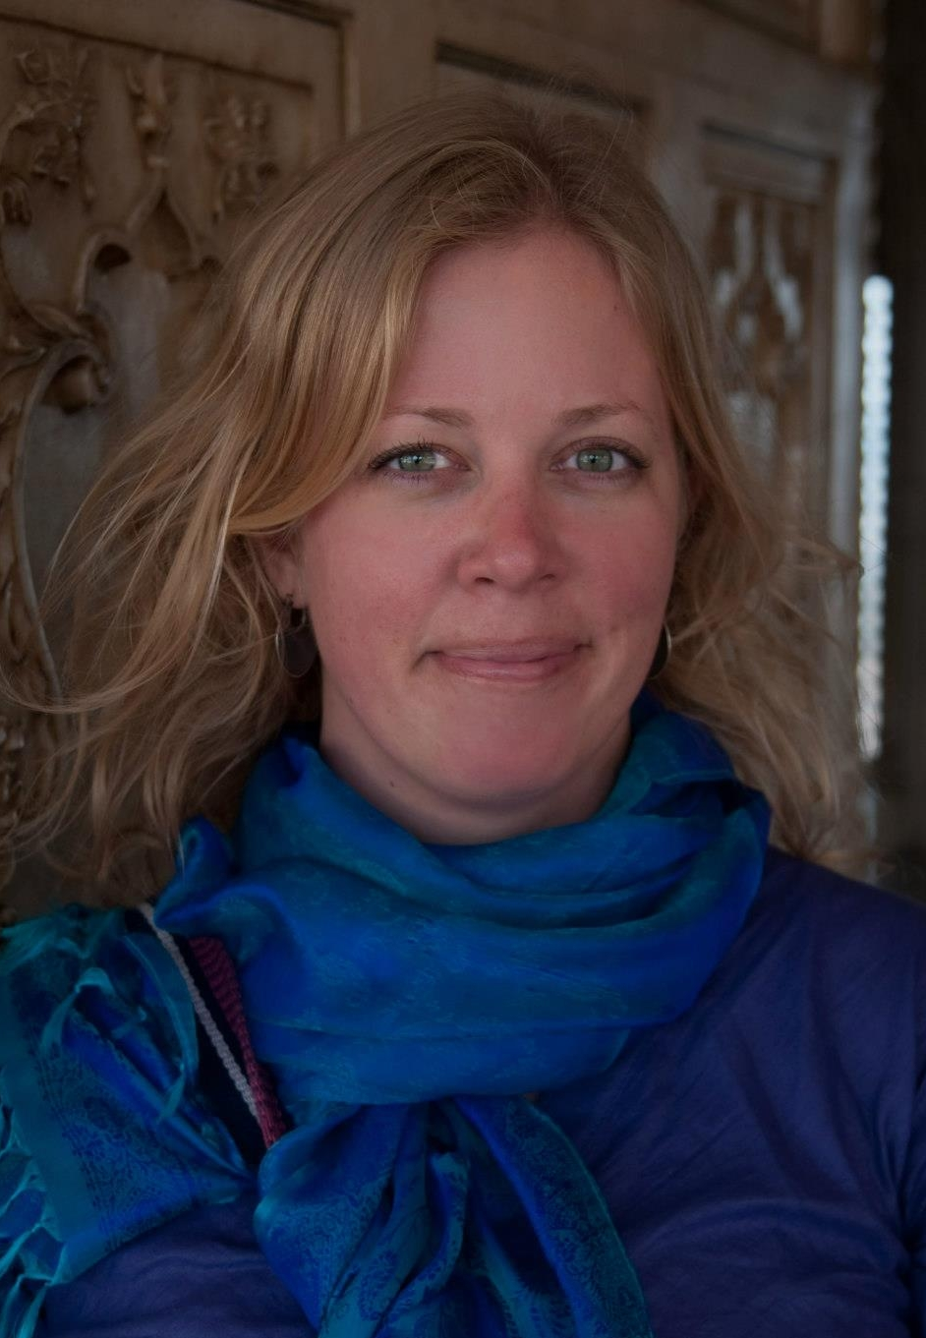
Perfil
Profesional
Laura has a diverse background and education. Her first career was in the high-paced, high-stress job of paramedicine/EMS in Toronto, Canada. Her rapid advancement of skills and education resulted in her becoming one of the youngest female advanced care paramedics in the city’s history. The search for a quieter, less stressful life, led Laura to move on—following her passion for food—and train as a Chef at the ICC in California, graduating top of her class with honors. She works as a private chef when in Nicaragua.
Laura’s desire to provide a world class travel experience has grown from her extensive travel around the world. She has visited over 50 countries—most recently travelling overland through Mozambique, South Africa, Swaziland, Zambia and Zimbabwe. This firsthand experience as a world traveler gives her insight into the global travel industry and vacation rental market. She splits her time between rural living on the coast of Nicaragua, and in the fast paced world-class city of Toronto with her husband of nearly 20 years, Joel.
A dedicated yogini, in her spare time you are likely to find Laura working on a new recipe in the kitchen before or after a yoga class.
Laura Johnson
Laura is a founding partner of Selva Pacifica Luxury Rentals, and our Chief Marketing Officer. She is primarily responsible for lead brand management (including advertising, promotions and public relations), marketing communications, market research and management of distribution channels.
As an early adopter of using both social media and third party booking platforms such as AIRBNB, Laura has promoted vacation rentals in Nicaragua for over nine years. Her energetic personality and wealth of experience has resulted in her being the top-rated Super Host in Nicaragua, with over 460 five-star reviews.
Chief Marketing Officer
Communications Officer

Slide 21
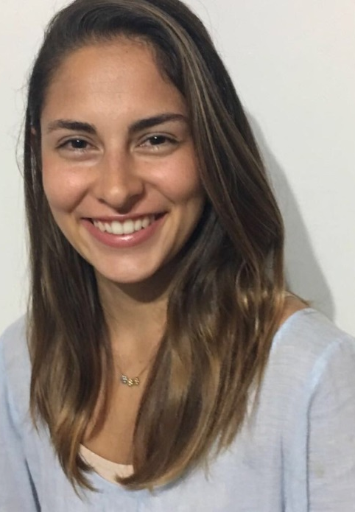
Professional
Profile
Veronica is a lover of a calm and balanced life. Recently, together with her husband Joao, they decided to follow a dream and move to live in the coastal zone of Nicaragua, leaving behind the comforts of the capital to offer their children a life closer to nature.
Her vocation to help others and the tools obtained through years of teaching make her a key element within Trinity Nicaragua. Veronica is responsible for coordinating the rental of properties in the coastal area through Super Hosts in the area; and to ensure that our rental clients have an exceptional experience, advising them at each stage of the process.
Veronica dedicates the rest of her time to her family and to the practice of Yoga.
Veronica Hueck
Veronica is described as a passionate person. Her biggest motivators are her 4 children, her family and Yoga.
Through this practice Veronica has managed to touch many people, generating a positive impact in their lives by sharing the physical, mental and spiritual advantages of this discipline. Veronica is a certified psychologist by profession and certified Yoga instructor. Through both careers she has experienced the pleasure of helping others.
Rentals Specialist

Slide 22
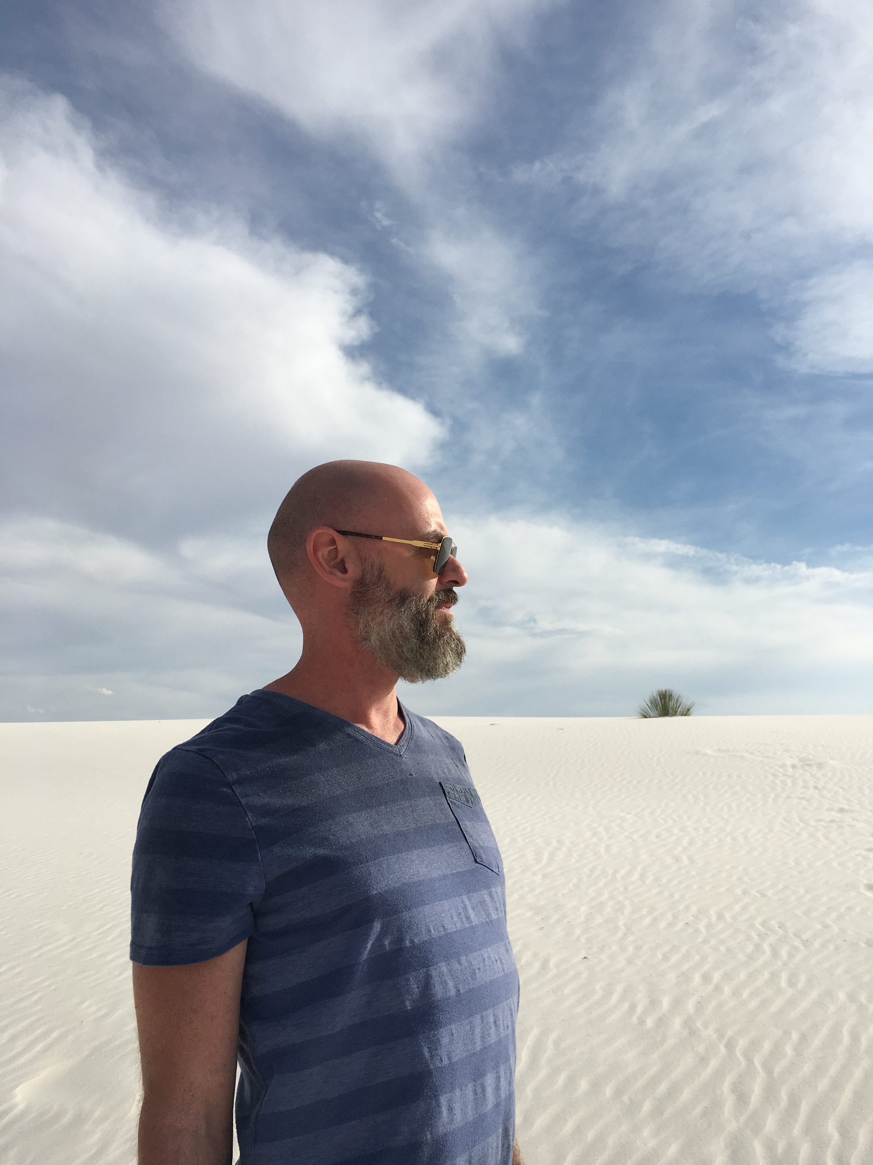
Perfil
Profesional
Recently, Joel has finished his Master’s degree in Communications and Media, with a particular emphasis on imagery found in social media content. His research, which he continues with Royal Roads University in Canada, investigates how people respond to the images they view on Instagram, and he will be presenting his finding at an upcoming international conference.
To this day, Joel loves being behind the lens of his camera, and capturing life’s moments. Travelling around the world with Laura has been his life’s highlight, and how together they found Nicaragua. Joel feels that by sharing this amazing country with others through images, they too will come to love this incredible and beautiful place, its people and its culture.
When Joel isn’t photographing a home, at yoga, or eating the food Laura is cooking, he is certainly making one mean cocktail. Perhaps hiring him and Laura for an evening dinner at one of Selva Pacifica’s luxurious homes would make for a perfect memory.
Joel Johnson
Joel is a founding partner in the Selva Pacifica brand and the Director of Content Strategy and Lead Photographer. Those incredible images of the homes you view were created by him. Joel ensures that what you see is carefully curated to ensure the beauty and amenities of the homes are accurately depicted. His architectural and travel photography has been published world wide in magazines, websites and print.
Joel’s background in photography started as a creative outlet after working long hours as an advanced care paramedic. Always an artistic person, whether music or drawing, photography became a natural fit. Very quickly, his images and talent became noticed. Initially, he began in the field of portrait photography, and when Joel and Laura started working in Nicaragua with homes, architectural photography for hotels and restaurants became his strength.
Director Content Strategy
Photographer

Slide 23
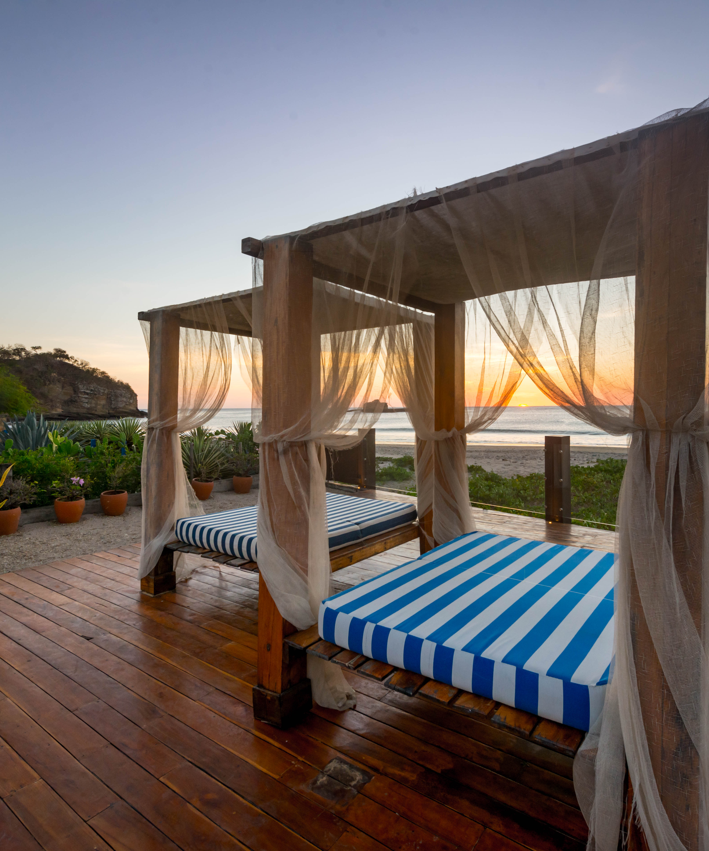
SELVA PACIFICA OWNERS
Homeowners are provided with a professional marketing package that includes professional photography, online marketing (social media, online booking platforms) and listing to Selva Pacifica’s website.
Creation, or rewriting, all existing vacation rental listings currently held by the Client.
Secure reservations for owner, collect and distribute funds, as well as manage damage deposits.
Owners are provided with book-keeping services related to reservations.
Maintain a shared Google calendar (or platform currently in use) with the Concierge Service/Manager related to reservations.
Reporting to onsite staff of guest issues related to home
We work to ensure the best guests possible end up in your home. We carefully screen guests, and collect a large damage deposit prior to entry.

Slide 24
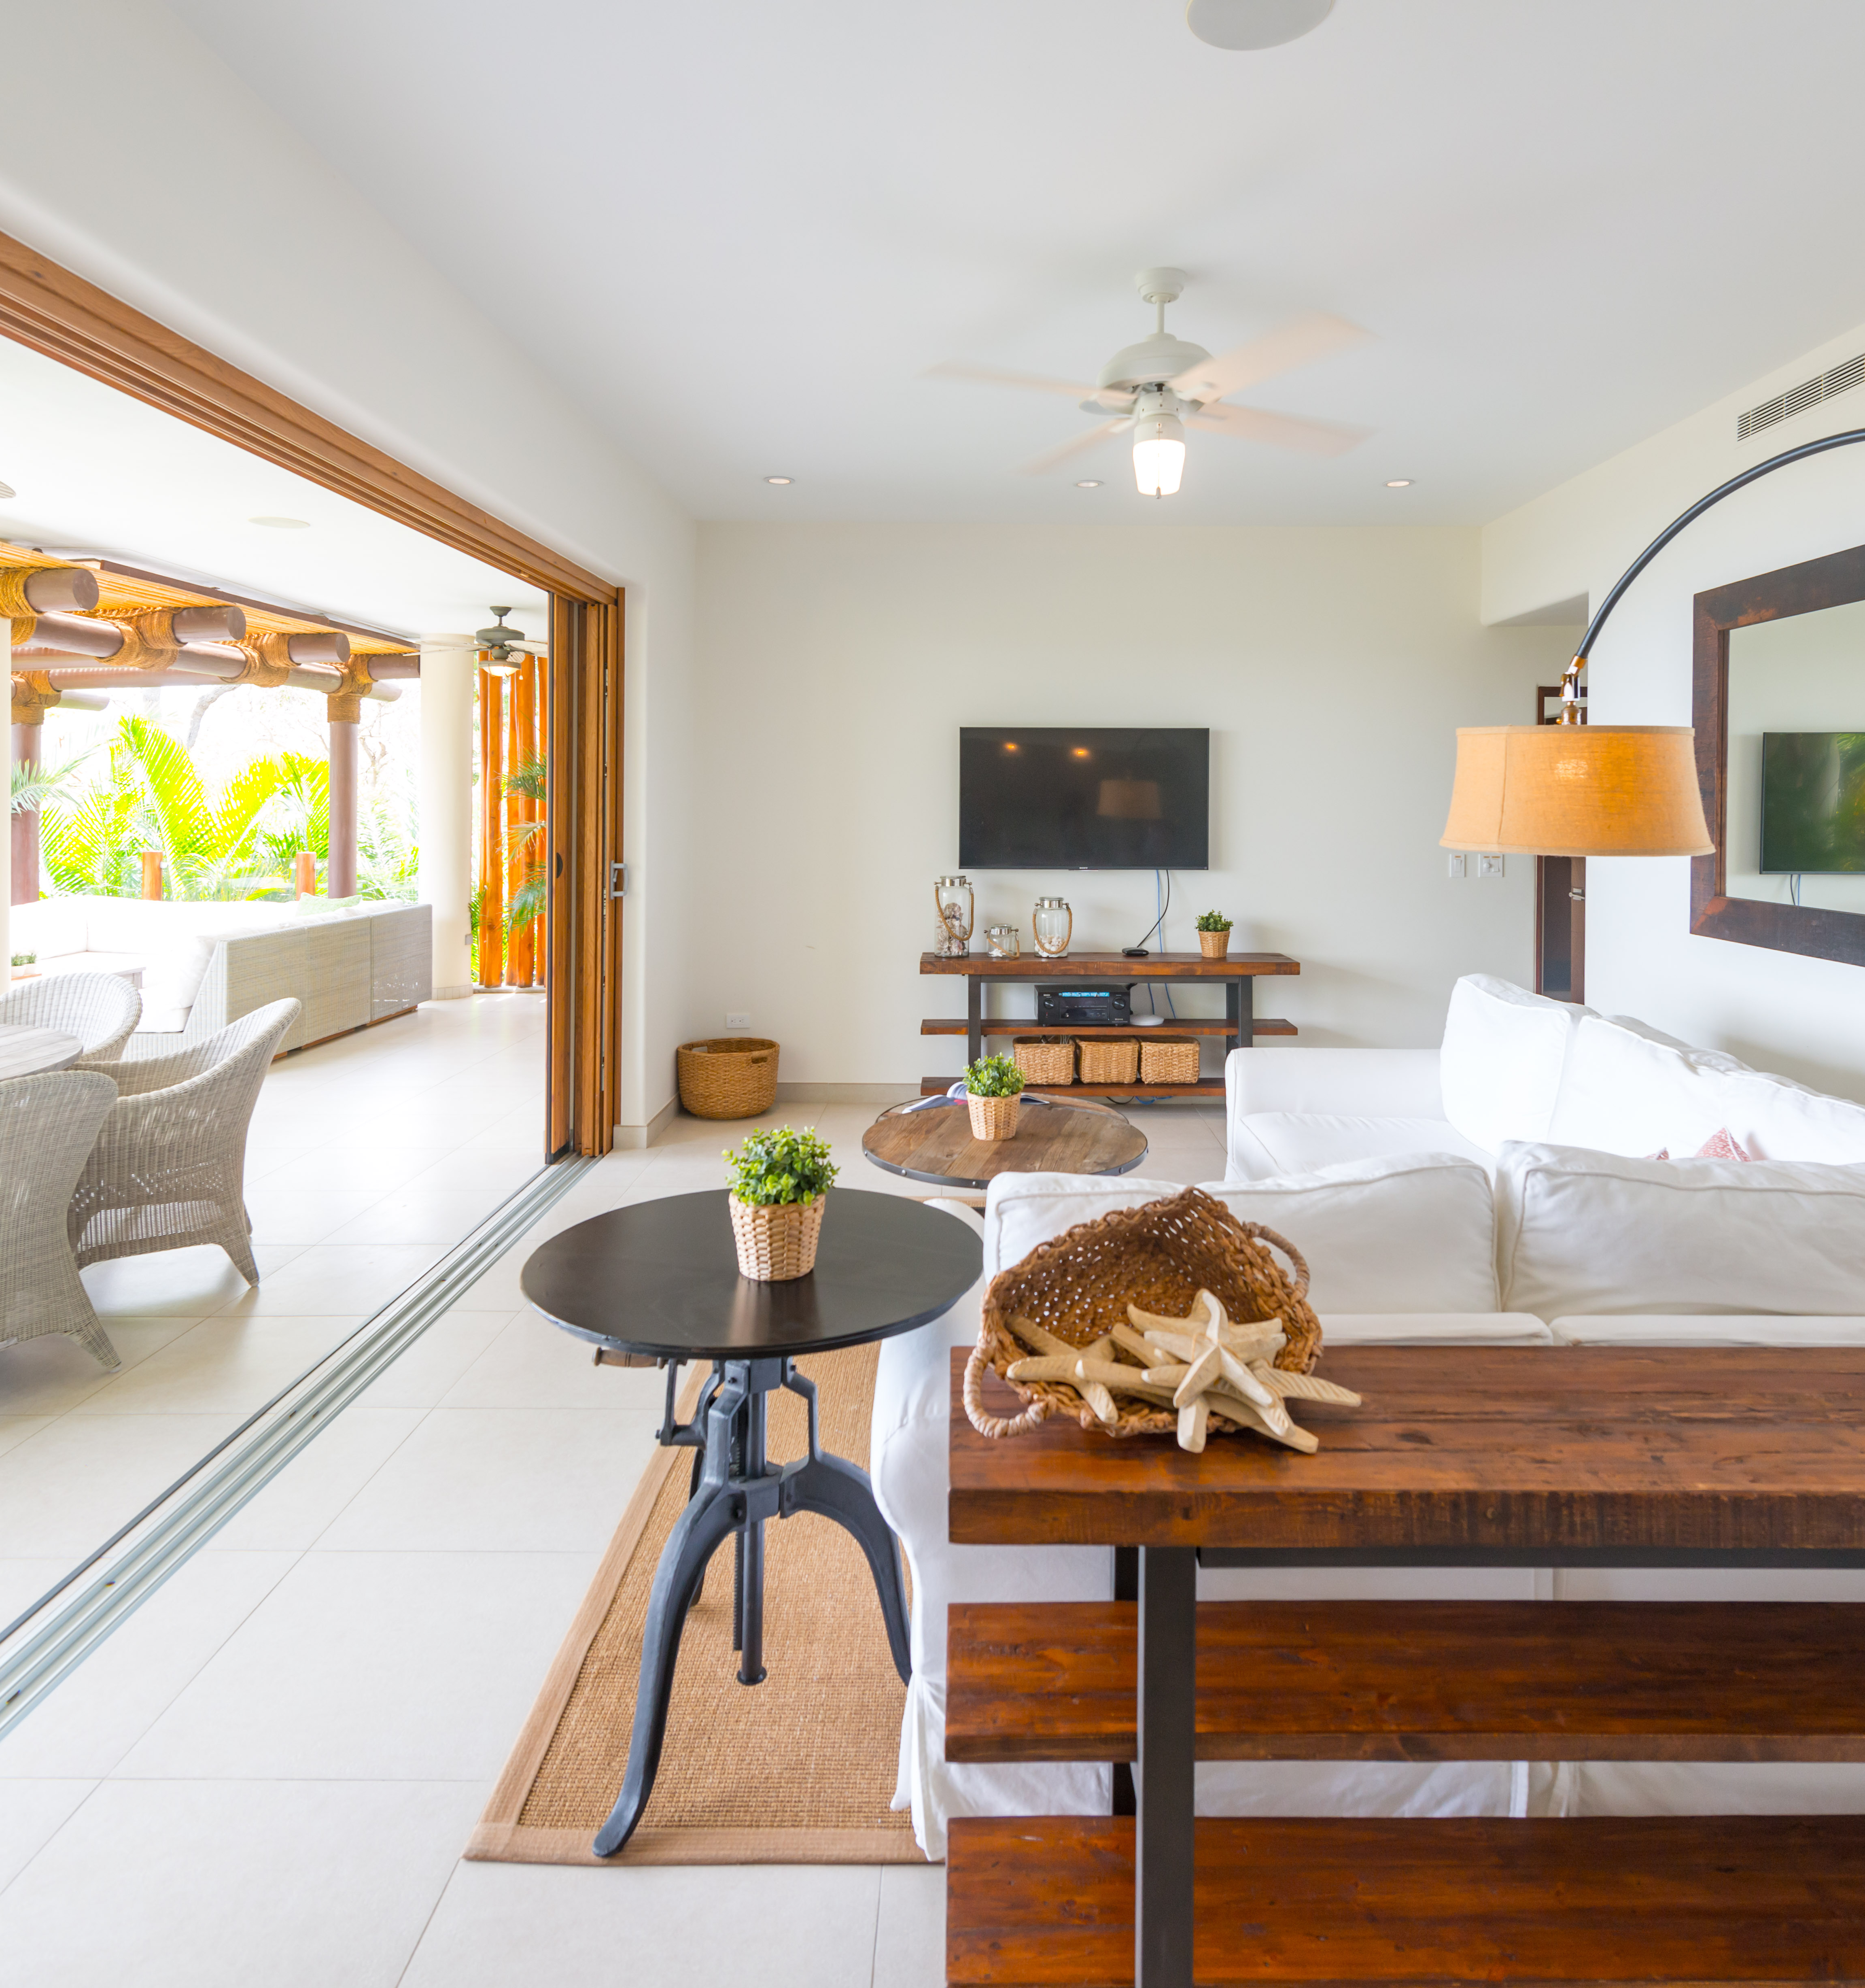
Selva Pacifica personally guarantees each of our unique vacation homes is outfitted with all the items you require to have an effortless stay.
Selva Pacifica provides each of their guests with a personalized vacation planner to assist with all aspects of the stay, assisting with travel plans, excursions, check in and check out.
Coordinating guest special needs with onsite staff for homes prior to arrival and contact both guest shuttle and rental company prior to arrival reconfirming bookings.
Escort guest from town to house on arrival with use of personal vehicles.
Late night arrivals met at home the following morning and shuttled to car rental location by meet and greet.
Tour of town and assistance with shopping.
Tracking lost luggage and arranging delivery to guest.
Available for duration of stay to assist with any and all questions.
SELVA PACIFICA GUESTS

Slide 25
Buy. Sell. Rent. Invest.
WWW.KWNICARAGUA.COM

